Slide 1

GAME RECOMMENDATION SYSTEM USING MACHINE LEARNING ALGORITHMS
Kutay KABADAŞ 201711039
Tolga BOLAT 201711008
Berfin VARLI 201711068

Slide 2

CONTENTS
INTRODUCTION
OUR MOTIVATION
PURPOSE
RECOMMENDATION SYSTEM IDEAS
TECHNOLOGIES USED
SIMILAR PROJECTS
DIAGRAMS
USER INTERFACE
WORK PLAN
CONCLUSION

Slide 3
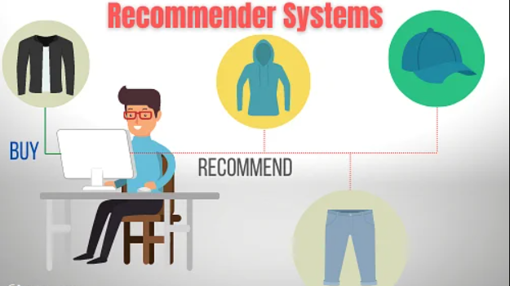
INTRODUCTION
Recommendation systems are algorithms that aim to suggest relevant items to users.

Slide 4
OUR MOTIVATION
There are 3.1 billion people playing video games at least one time in 2 days. We have seen that, software developers make life much easier. So, we decided to eliminate the time to search for games that people want to play. Us, as videogame players, found us lost as we staring blankly at screen, don’t know what to play. That’s when we decided that we need to find a solution to this problem.

Slide 5
PURPOSE
The aim of this project is to develop a system that can give game recommendations to people who are looking for games they may like based on the games they have liked before or the users that have similar history with the current user.
Main Features:
Predicting games that user might enjoy.
Rate and comment section for users.
Display and search among the database for games.

Slide 6
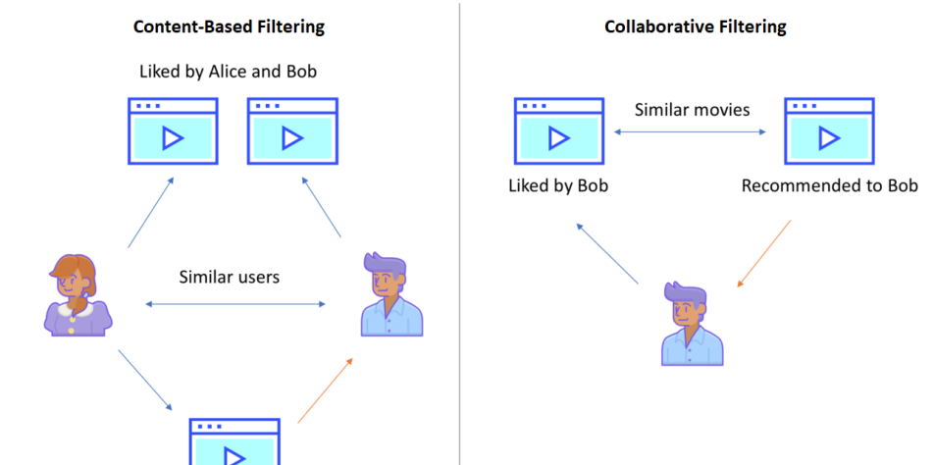
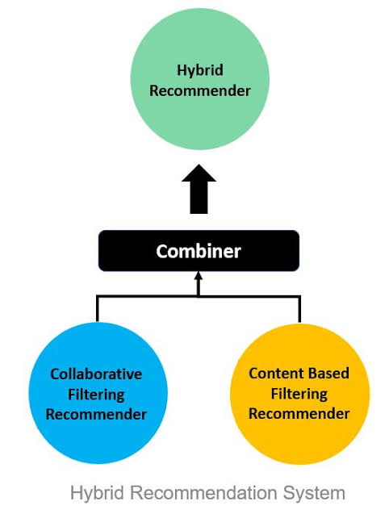
RECOMMENDATION SYSTEM IDEAS
There are 3 major recommendation methods:
Content-Based Filtering Method
Collaborative Filtering Method
Hybrid Recommendation

Slide 7
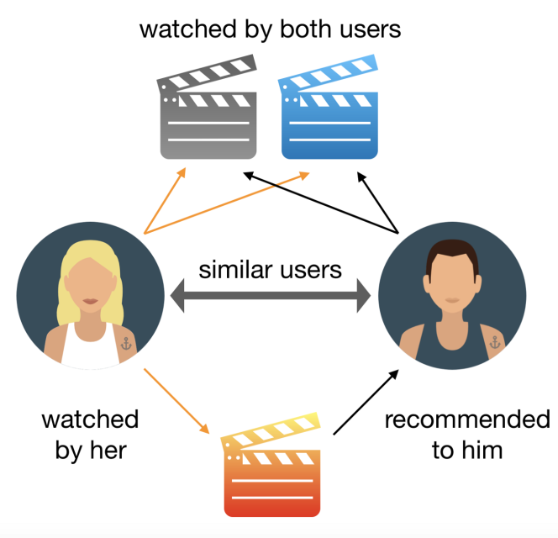
CONTENT-BASED FILTERING METHOD
The main idea is that get the essential information about user in order to make predictions.
The system requires user to enter features such as gender, age, location etc. Then checks similarity between other users.

Slide 8
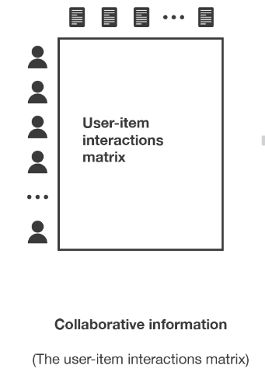
COLLABORATIVE FILTERING METHOD
Collaborative methods are methods that are based on the past interactions recorded between users and items.

Slide 9
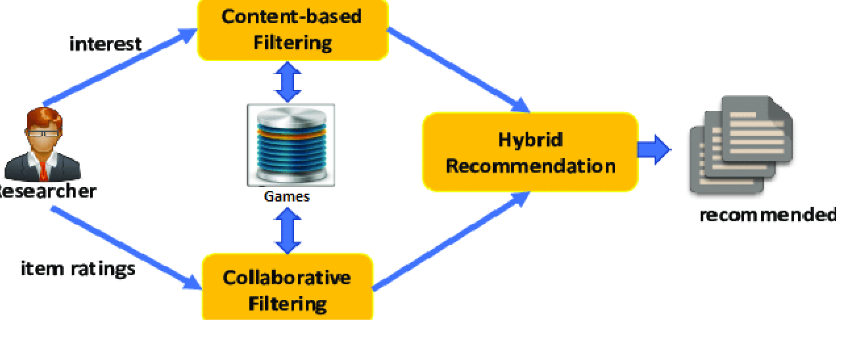
HYBRID RECOMMENDATION SYSTEM
This method combines both content-based filtering and collaborative filtering methods. It either independently combines or combines them into a single model.

Slide 10



TECHNOLOGIES USED
Python – ML Algorithms
LightFM – The Library for ML Evaluation
Firebase Database – Database for User Statistic
React-Native – Mobile App Development Tool

Slide 11




SIMILAR PROJECTS
Steam’s Recommendation System - Collaborative
Netflix’s Recommendation System – Hybrid
IMDb’s Recommendation System - Hybrid
Amazon’s Recommendation System - Collaborative

Slide 12
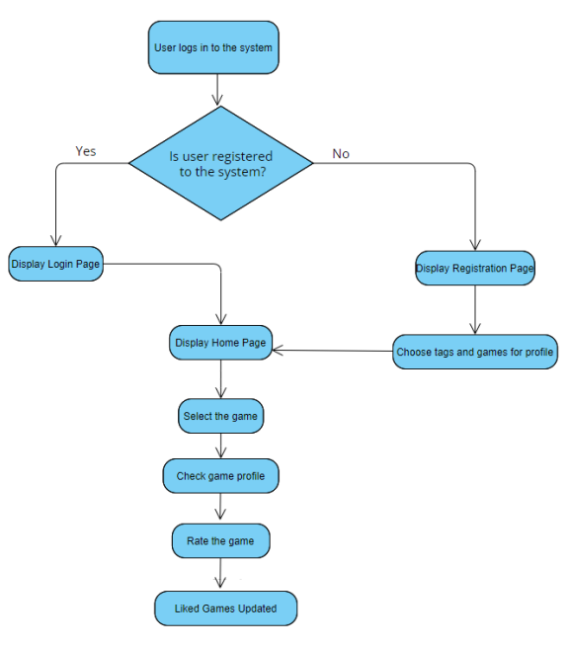
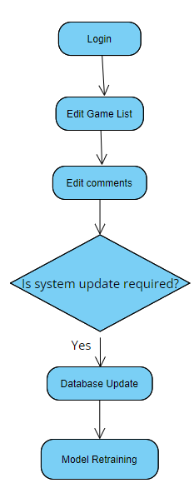
ACTIVITY DIAGRAM
Admin Activity Diagram
User Activity Diagram

Slide 13
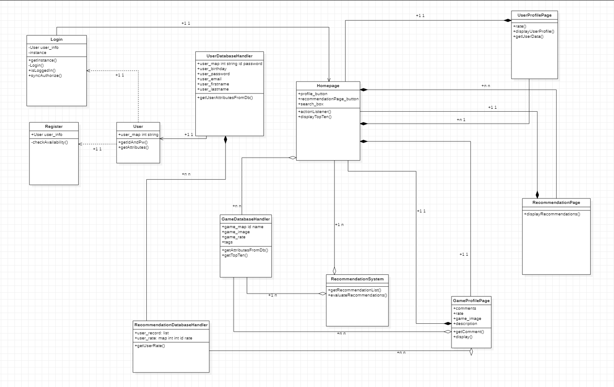
CLASS DIAGRAM

Slide 14
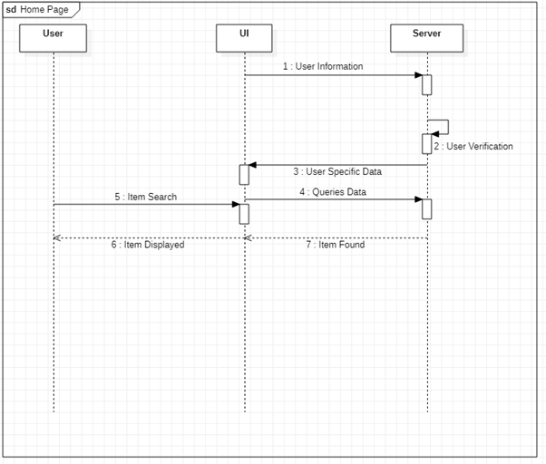
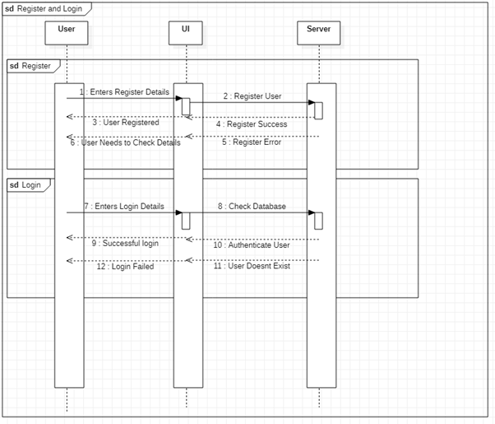
SEQUENCE DIAGRAM
Register and Login Diagram
Home Page Diagram

Slide 15
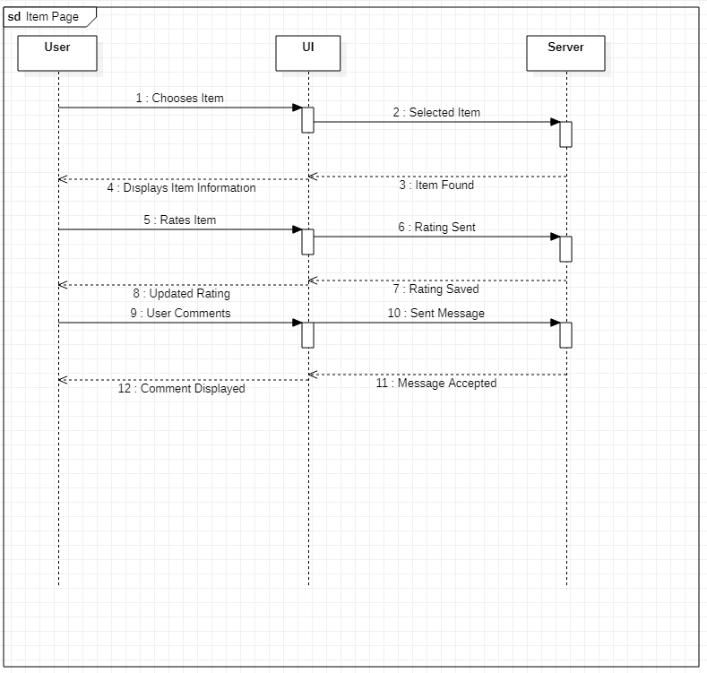
SEQUENCE DIAGRAM(CONT)
Game Page Diagram

Slide 16
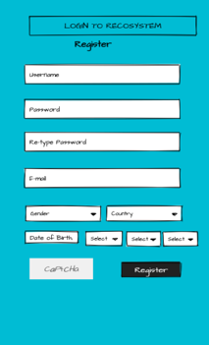
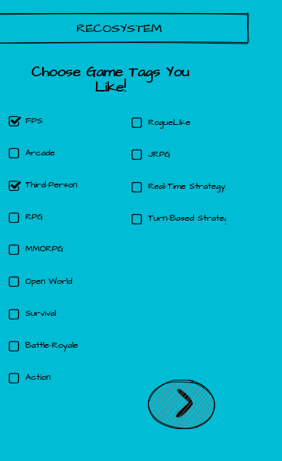
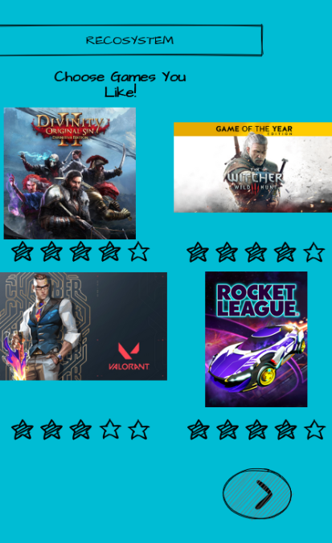
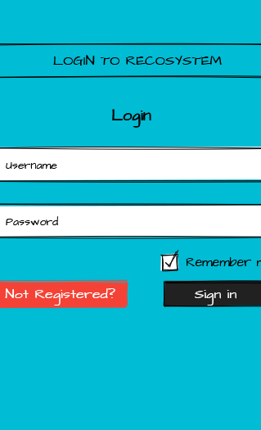
USER INTERFACE
Register Page
Tag Settings Page
Liked Games Page
Login Page

Slide 17
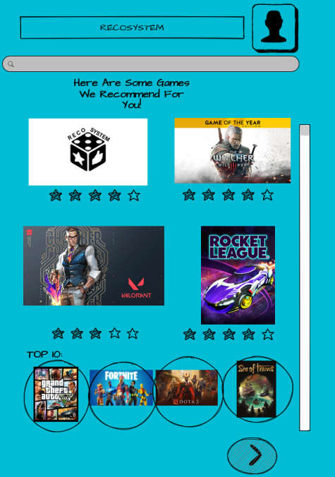
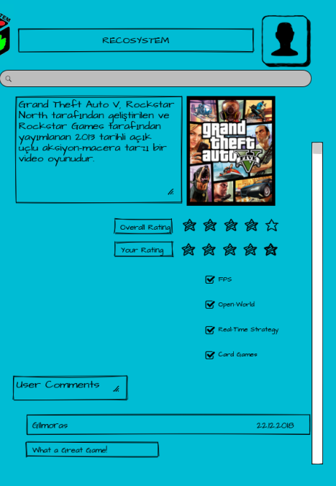
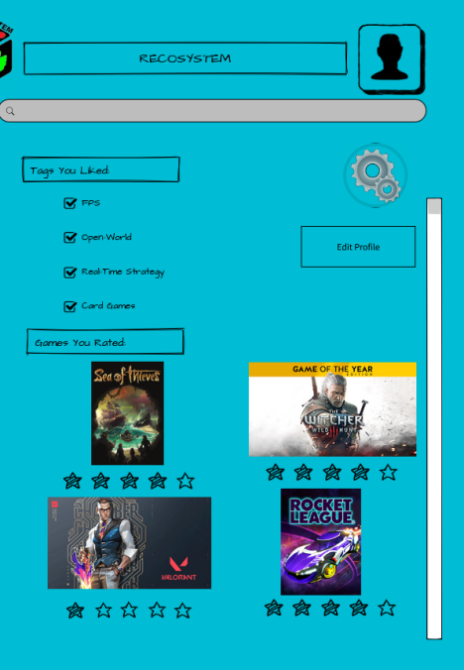
USER INTERFACE(CONT)
Homepage
Game Profile Page
User Profile Page

Slide 18
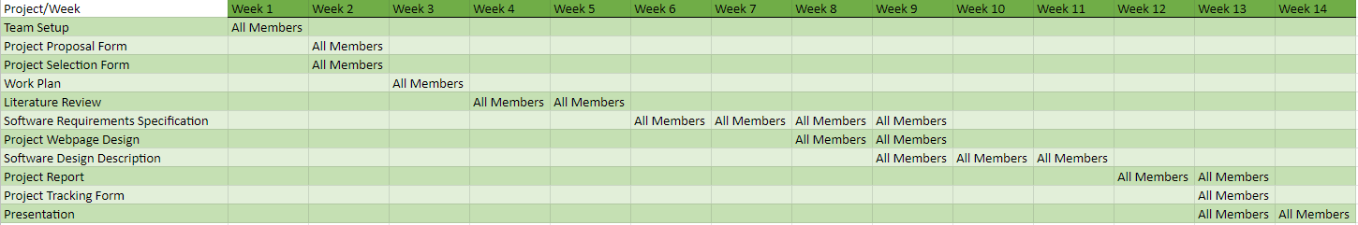
WORK PLAN

Slide 19

CONCLUSION

Slide 20

THANK YOU FOR LISTENING!

